Slide 1
Hr analytics at scalene works: Behavioral Modeling to predict renege
Saif Rizvi
Pallavi Mazumdar
Rishabh Chaudhary

Slide 2
INTRODUCTION
Acquiring new talent has always been a time consuming and challenging task since the hired person has to adapt to a fast changing technology and when the selected person fails to join after accepting the offer, it comes at a huge cost since the HR Department has to go through the entire process.
ScaleneWorks is a first true end-to-end talent acquisition solutions organization which had the passion to providing talent acquisition solution using Analytics.

Slide 3
Problem Statement
Candidates accepting the job offer but not joining the company.
Example: The impact for a client where 12,000 offers were rolled out every year. At 30% renege rate, about 3,600 candidates would accept the offer and then not join the company.
Even with the most conservative estimates, on average, organizations would have spent 15 man hours per candidate in the recruitment lifecycle, effectively indicating a humongous loss of 54,000 man hours wasted by one client alone

Slide 4



Tools used
Utilized Power Query Editor and Excel to connect, prepare and transform data.
Utilized Power Bi to Visualize the data.
Utilized Python(Jupyter Notebook) for the Machine Learning algorithm.

Slide 5
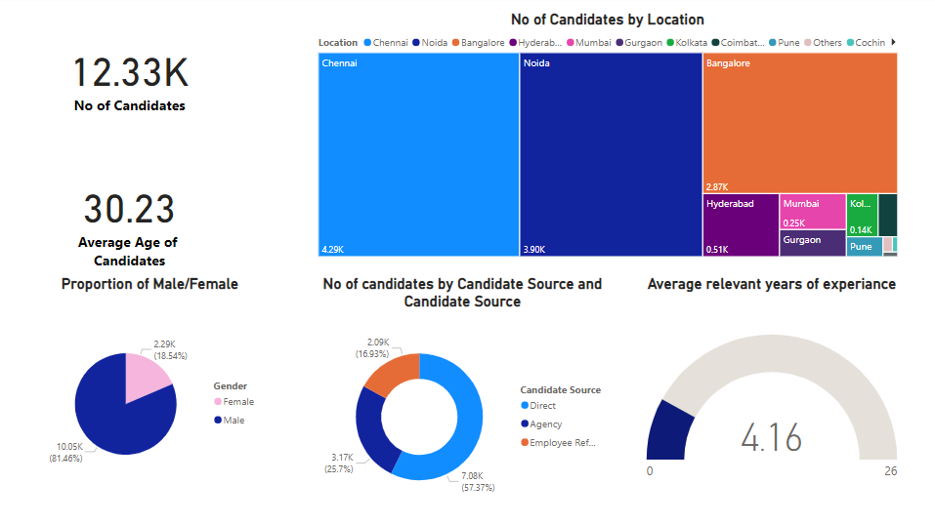
DATA VISUALISATION

Slide 6
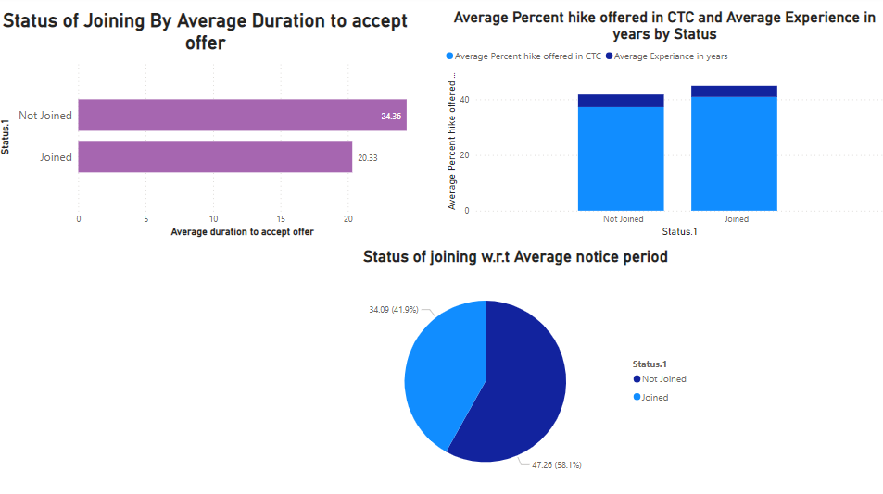
Analysis of the Features/reasons behind renege

Slide 7
Solution
Identify Key Drivers that influence a candidate joining or not joining a company.
Rules that can be used to predict renege
Devising a predictive algorithm to calculate the probability of joining the company after accepting the offer.

Slide 8
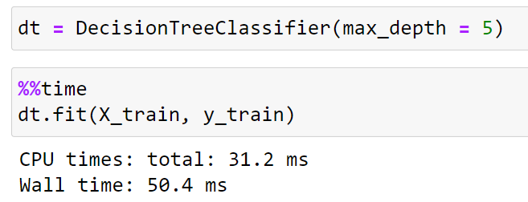
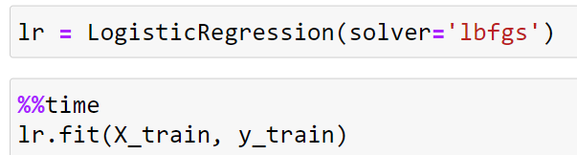

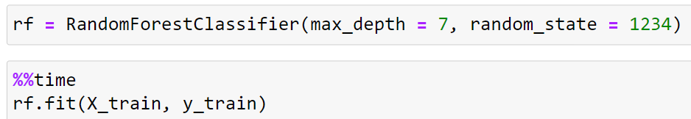
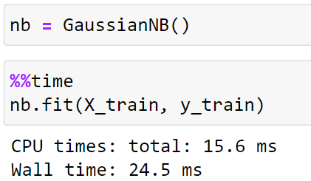
Machine learning

Slide 9
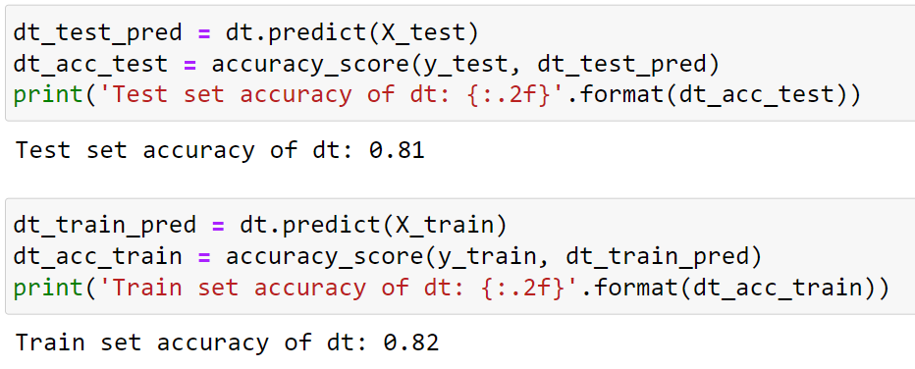
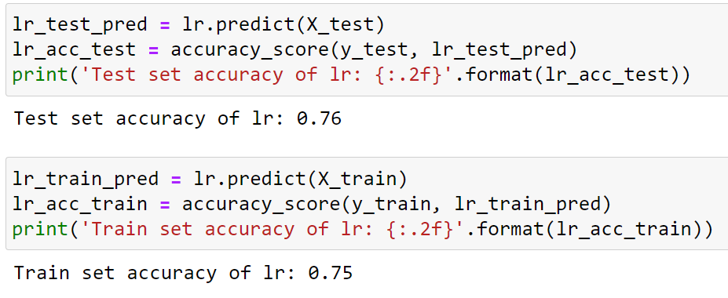
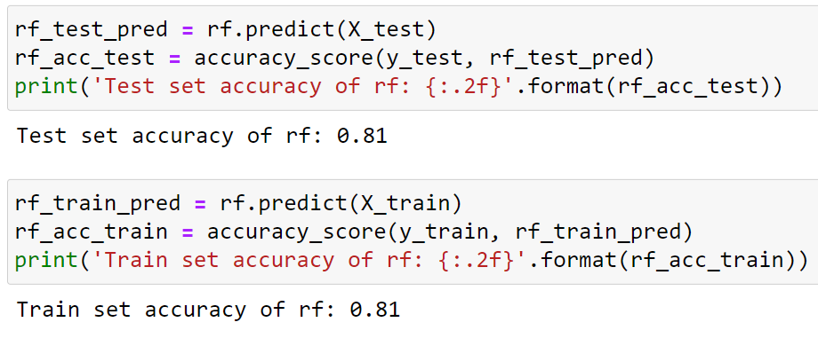

Machine learning

Slide 10
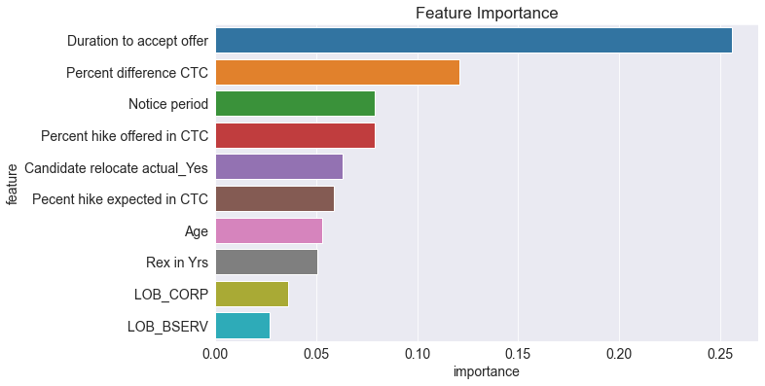
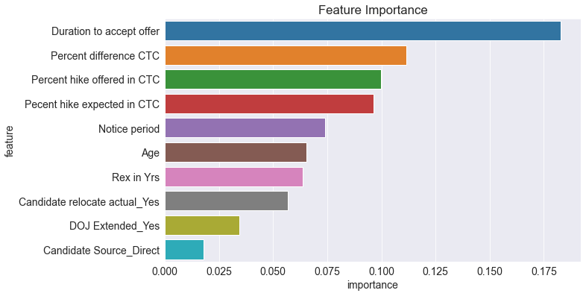
Machine learning
Random Forest
Decision Tree

Slide 11
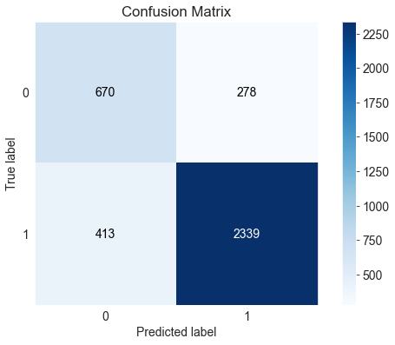
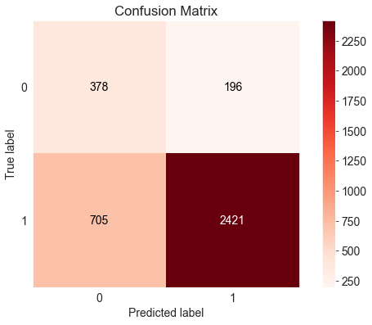
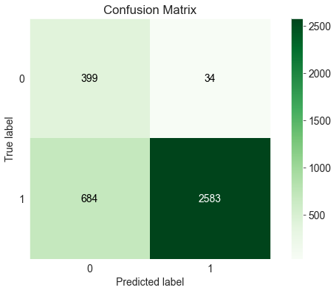
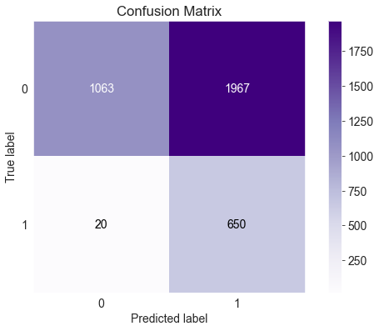
Machine Learning
Random Forest
Naïve Bayes
Decision Tree
Logistic Regression

Slide 12
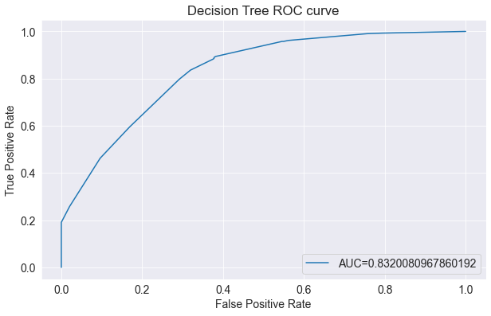
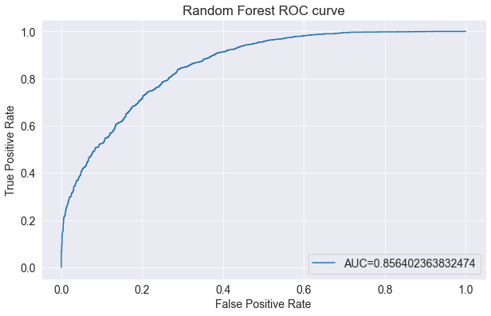
Machine Learning

Slide 13
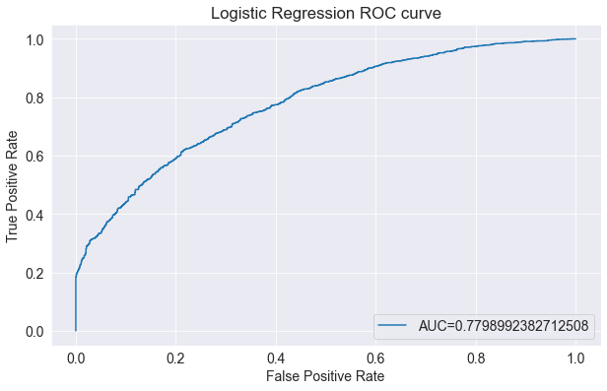
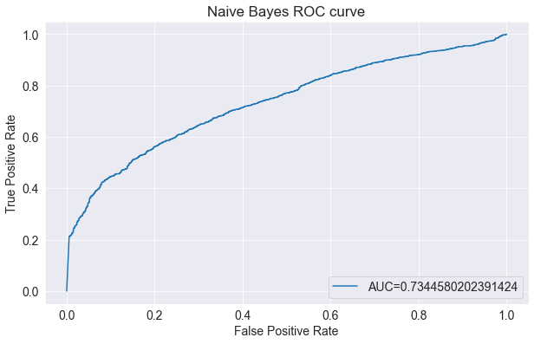
Machine Learning

Slide 14
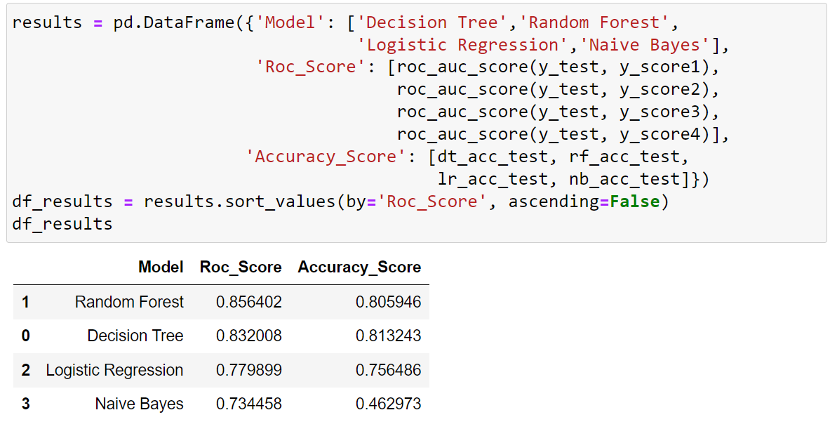
Machine Learning

Slide 15
THANK YOU

